Slide 1
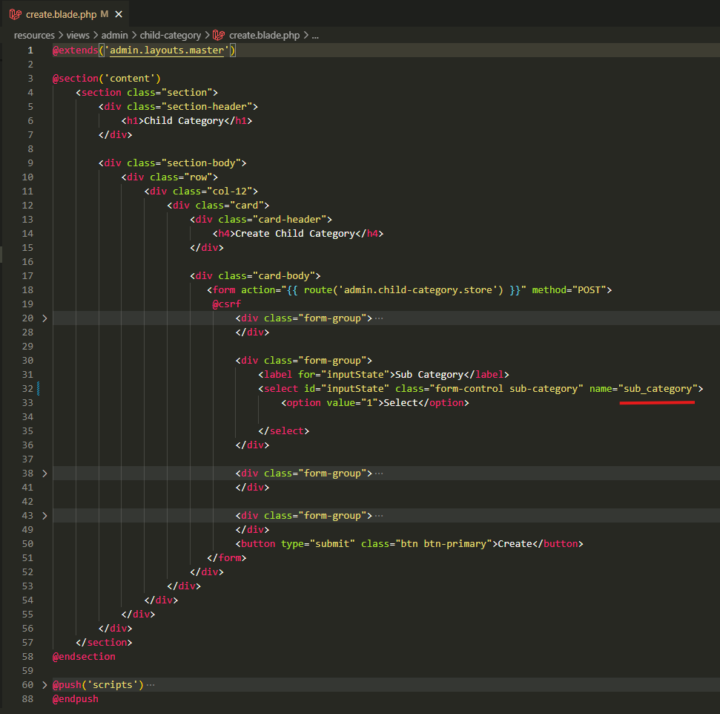
resources\views\admin\child-category\create.blade.php

Slide 2
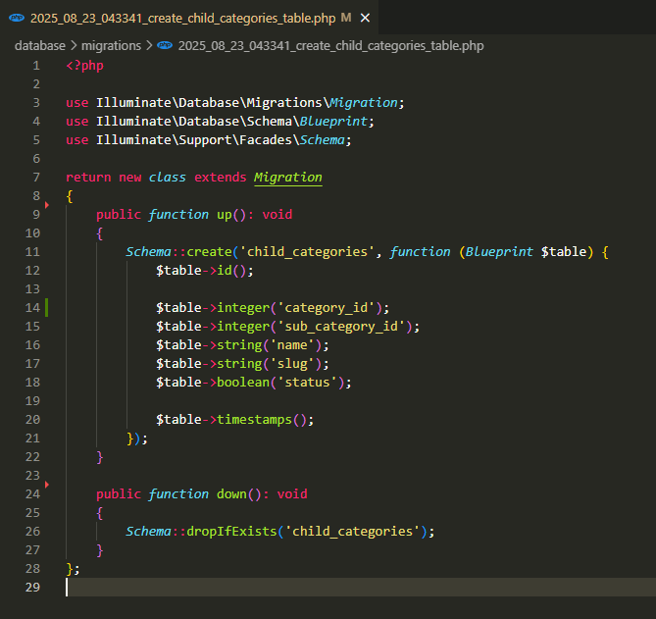
database\migrations\2025_08_23_043341_create_child_categories_table.php

Slide 3
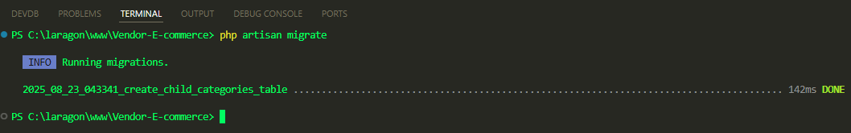
.

Slide 4
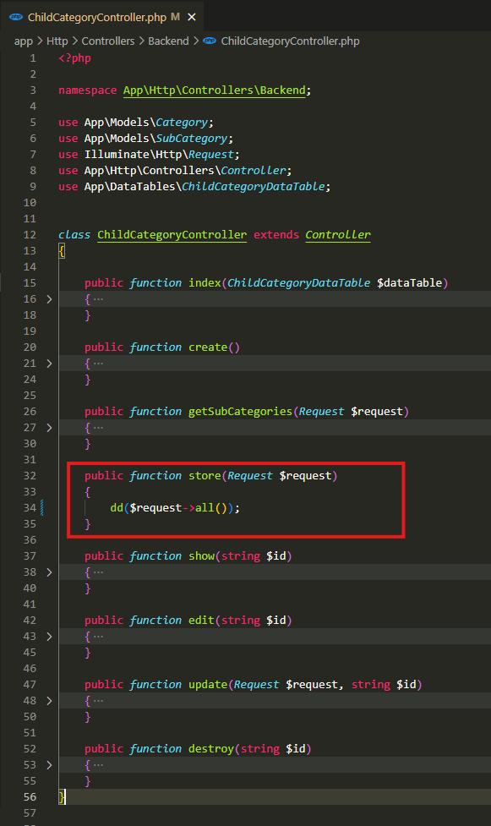
app\Http\Controllers\Backend\ChildCategoryController.php

Slide 5
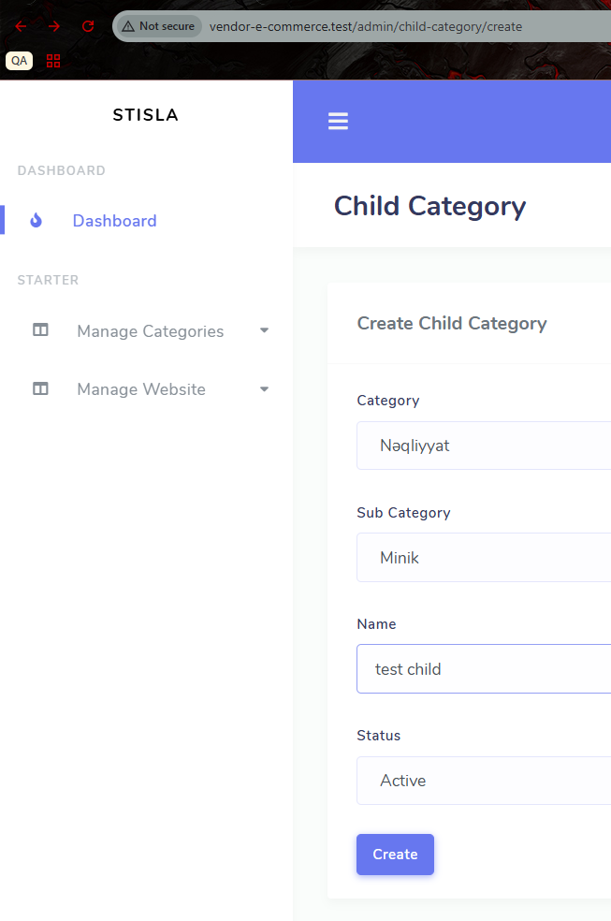
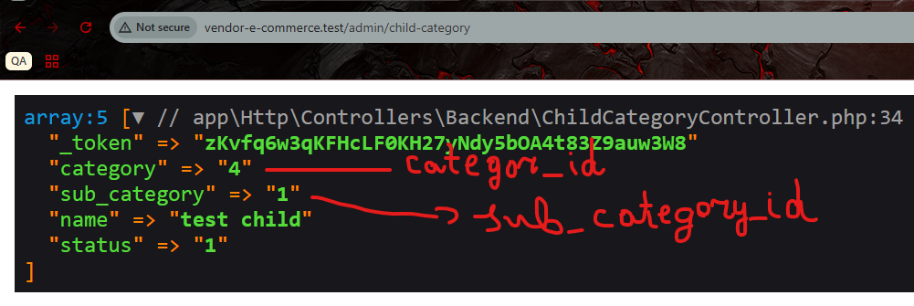
.

Slide 6
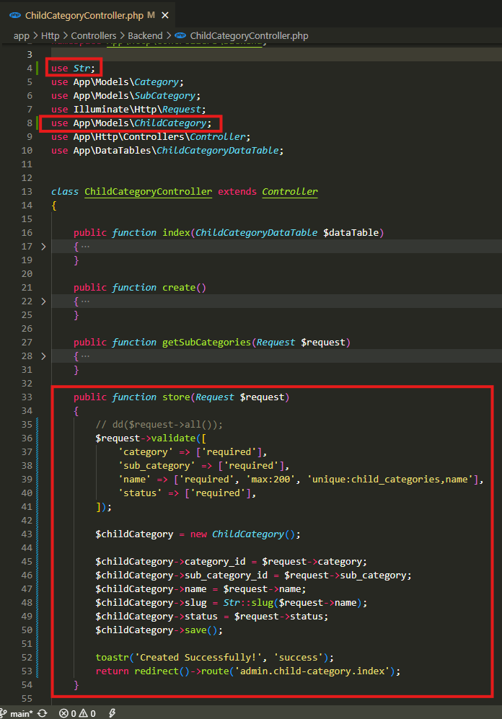
app\Http\Controllers\Backend\ChildCategoryController.php

Slide 7
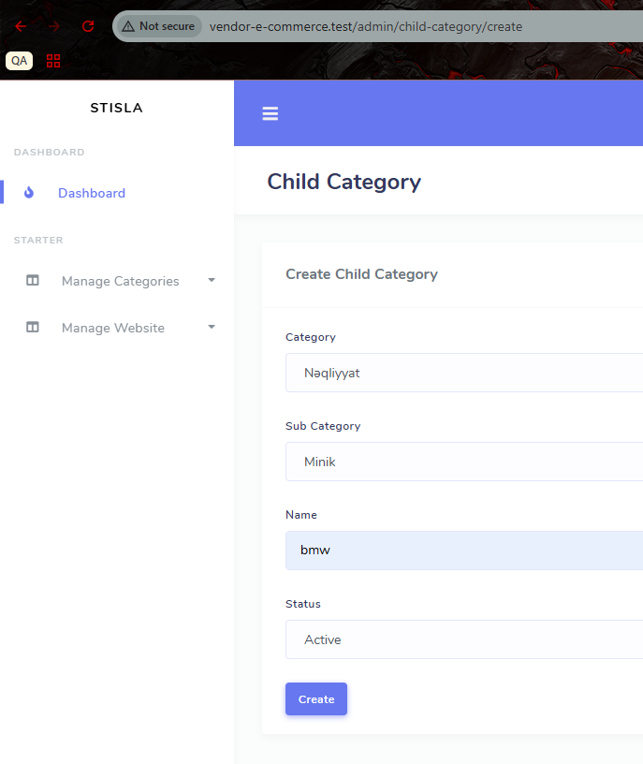
.

Slide 8
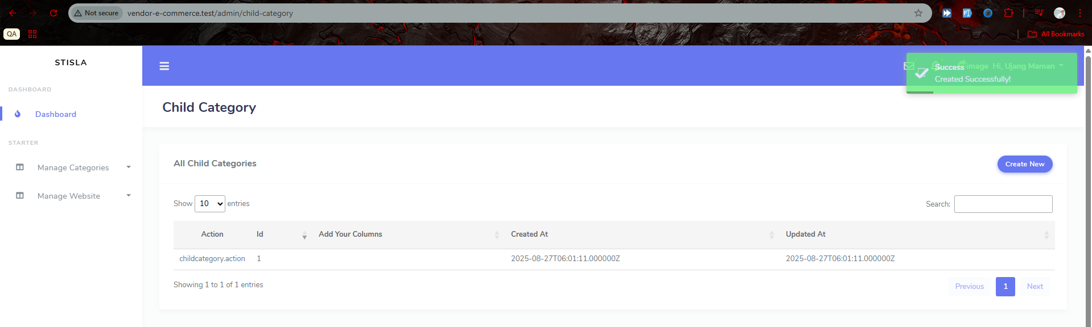
.

Slide 9
.

Slide 10
.

Slide 11
.

